Slide 1
Nursing Care Plans (Gold Standard for Nursing care)

Slide 2
Objectives:
At the end of this presentation, students will be able to know about:
What is Nursing Process
What are the characteristics of Nursing Process
What are the benefits of Nursing Process
Phases of Nursing Process including:
Assessment (purpose, types, steps, skills)
Nursing diagnosis (types, benefits, components)
Planning (steps & elements)
Implementation
Evaluation

Slide 3
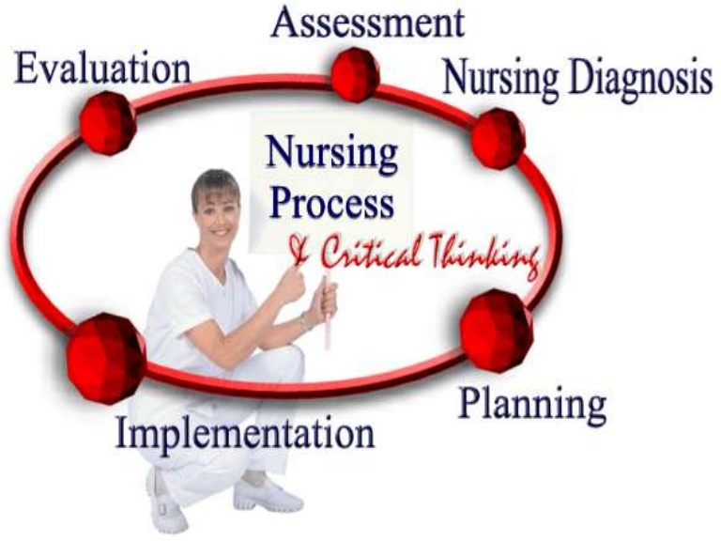

Slide 4
Nursing Process
The nursing process is a modified form of scientific method used in nursing profession to assess client needs and create a course of action to address and solve patient problems.
Nursing process is a rational problem solving framework on which professional nursing practice is based. It provides an organized, systematic approach to nursing care thereby improving the probability of positive outcomes for individuals and groups.

Slide 5
Nursing Process
Scientific Method
Planning
Implantation
Evaluation
Diagnosis
Assessment
Hypothesis
Experiment
Analyze/Conclusion
Identify Problem
Ask Question

Slide 6
Benefit Of Nursing Process
Provides an orderly & systematic method for planning & providing care
Enhances nursing efficiency by standardizing nursing practice
Facilitates documentation of care
Provides a unity of language for the nursing profession
Nursing Process is economical
Stresses the independent function of nurses
Increases care quality through the use of deliberate actions
Provide continuity of care and prevent duplication

Slide 7
Characteristics Of Nursing Process
Interactive, Purposeful and Systematic (organized)
Client-centered
Goal-directed, outcome focused
Within the legal scope of nursing
Prioritizing the needs
The steps are interrelated and dependent on the accuracy of each of the preceding steps
It is used to identify, diagnose, and treat human responses to health and illness

Slide 8
LVN vs RN
The RN is responsible for initiating the careplan.
The LVN CANNOT initiate the careplan, but is responsible for following careplan and adding to it.

Slide 9
Assessment

Slide 10
Assessment
Assessment is the first step of nursing process and may be defined as collecting, organizing, validating and documenting client data
During this phase, the nurse gathers information about a patient's psychological, physiological, sociological, and spiritual status through observation, interviewing, physical examination, health records and family members.

Slide 11
Assessment (cont….)
Nursing assessments do not duplicate medical assessments (which target to pathologic conditions) but focus on the patient’s responses to health problems or potential health problems

Slide 12
Types of Assessment
Initial assessment: Also known as triage, is performed within a specified time after admission to establish a complete database for problem identification, reference, and future comparison. Done by the Registered Nurse.
Problem-focused assessment: is an ongoing process integrated with nursing care to determine the status of a specific problem identified in an earlier assessment.
Emergency assessment: occurs during any physiologic or psychological crisis of the client to identify the life-threatening problems and to identify new or overlooked problems.
Time-lapsed assessment: occurs several months after the initial assessment to compare the client’s current status to baseline data previously obtained.

Slide 13
Purpose Of Assessment
To establish baseline information on the client
To determine the client’s normal function
To determine the client’s risk for dysfunction
To determine the client’s strengths
To provide data for the diagnosis phase

Slide 14
Assessment Skills
Observation
Interview:
a conversation with purpose to get or give information, to teach and provide support.
Physical Examination:
a systematic data collection method by inspection, palpation, percussion and auscultation.
Intuition (Insight):
Use of insight, instinct, and clinical experience to make clinical judgments about the client.

Slide 15
Assessment Activities
Activities or action performed during assessment are:
Collect Data
Validate Data: Double checking the data to confirm accuracy
Organize Data : Grouping the data using Head to Toe model, Systemic Review etc
Document Data: Documents subjective data in client own words and objective using medical terms, key, abbreviations etc.

Slide 16
Collect Data
The process of gathering information about the client that begin with the first client contact, using method/skills of assessment (Observation, PE, Interview etc). Two type of data to be collected:
Subjective Data: including symptoms, client's feeling and statement about his/her health problems which should be recorded as direct quotations from the client, such as '' Every time I move, I feel pain.'‘
Objective data: including signs or observable and measurable data that are obtained through observation, physical examination, and laboratory testing.

Slide 17
Sources of data
Primary
The client is the primary source of data.
Secondary
Family members or other supporting persons,
Health professionals,
Health records and reports,
Laboratory and diagnostic analyses,

Slide 18
Nursing Diagnosis

Slide 19
Nursing Diagnosis
Nursing Diagnosis is a clinical judgment about individual, family, or community responses to actual or potential health problems/life processes.
Nursing diagnoses provide the basis for selection of nursing interventions to achieve outcomes for which the nurse is accountable.

Slide 20
Benefits Of Nursing Diagnosis
Gives Nurses a Common Language.
Promotes identification of appropriate goals or correct choice.
Can create a standard for nursing practice.
Provides a quality improvement base.

Slide 21
Components of Nursing Diagnosis
A typical nursing diagnosis statement has two or three parts/statements.
In two parts nursing diagnosis, the first component is a problem statement or diagnostic label (as listed in NANDA), while second component is the etiology. Both of these parts are linked by the term related to (RT). E.g. Disturbed Body Image RT loss of left lower extremity
***The three part nursing diagnosis statement consists of Problem, Etiology and Sign, Symptoms (defining characteristics) joined to the first two component by connecting phrase “as evidence by” (AEB). E.g. “ineffective Airway clearance RT fatigue AEB ‘O’dyspnea at rest and ‘S’ patient stating “I can’t breath when I am lying down”.”
Notes:
NANDA = North American Nursing Diagnosis Association

Slide 22
NANDA-I
3 Part Nursing Diagnosis:
1) Problem and Etiology (NANDA-I diagnosis list)
2) r/t (related to) Signs and Symptoms
3) AEB (as evidenced by) Subjective and Objective Data

Slide 23
Descriptive Words
To clarify nursing diagnosis, descriptive words or terms may be added before or after the problem statement. These words include Acute, Chronic, Decreased, Deficient, Depleted, Disturbed, Dysfunctional, Enhanced, Excessive, Impaired, Increased, Ineffective, Intermittent, Potential, and Risk for.

Slide 24
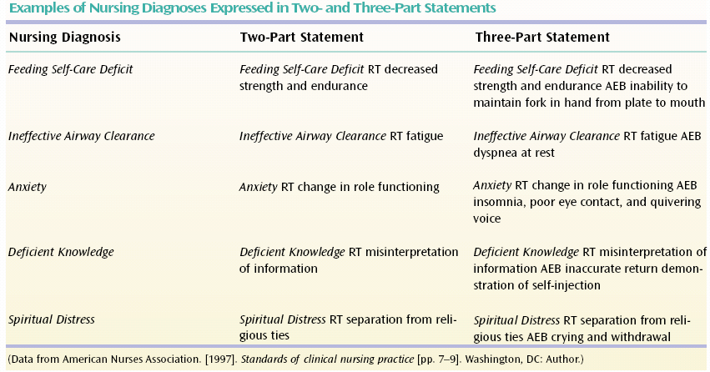

Slide 25
Types Of Nursing Diagnosis
Actual nursing diagnosis
Risk nursing diagnosis
Wellness nursing diagnosis
Syndrome nursing diagnosis

Slide 26
Actual
An actual nursing diagnosis is the diagnosis about current problem that is present at the time of the nursing assessment, based on the presence of signs and symptoms.
Examples of an actual nursing diagnosis are anxiety characterized by fear, panic, apprehension and sleep disturbances, or an ineffective airway clearance characterized by an ineffective cough, abnormal breathing or a fever.

Slide 27
Risk Nursing Diagnosis
Risk nursing diagnosis describes human responses to health conditions that may develop in a vulnerable individual, family, or community.
Risk nursing diagnoses are two – part statements, do not include defining characteristics.
Examples –
Risk for infection related to surgery or immunosuppression.
Risk for aspiration related to reduced level of consciousness

Slide 28
Wellness nursing diagnosis
A clinical judgment about a person’s, family’s or community’s motivation and desire to increase wellbeing as expressed in the readiness to enhance specific health behaviors, and can be used in any health state.
Wellness nursing diagnosis are one part statement includes diagnostic label.
Example
Readiness for enhanced spiritual well being
Readiness for Enhanced Self-Esteem.

Slide 29
Syndrome Nursing Diagnosis
A clinical judgment describing a specific cluster of nursing diagnoses that occur together, and are best addressed together and through similar interventions.“
An example of a syndrome diagnosis is: Relocation stress syndrome.

Slide 30
Difference b/w Medical & Nursing Diagnosis
Nursing Diagnosis | Medical Diagnosis
Clinical judgment about individual, family, or community responses to actual and potential health problems or life processes | Identification of a disease condition based on a specific evaluation of physical signs, symptoms, history, diagnostic tests, and procedures
The goal of a nursing diagnosis is to identify actual and potential responses | The goals of a medical diagnosis is to identify the cause of a illness or injury and design a treatment plan
Nurse treats problem within scope of independent nursing practice | Physician directs treatment for medical diagnosis
May change from day to day as the patient’s responses change | Remains the same as long as the disease is present

Slide 31
Nursing diagnosis for Medical diagnosis

Slide 32
Planning

Slide 33
Planning
Planning is to formulate the way to manage the problem.
The third step of the nursing process includes the formulation of guidelines that establish the proposed course of nursing action in the resolution of nursing diagnoses and the development of the client’s plan of care.
Planning consists three stage:
Initial Planning
On-going planning
Discharge planning

Slide 34
Steps Of Planning
Initial Planning
Done by the nurse who perform admission assessment in order to prioritize problems, identify goals and correlate nursing care to resolve the problems.
Ongoing planning
Involves continuous updating of the client’s plan of care. Every nurse who cares for the client is involved in ongoing planning.
Discharge planning
involves anticipation and planning for the client’s needs after discharge.

Slide 35
Elements Of Planning
Prioritizing the problems/nursing diagnosis
Formulate goals/desired outcomes
Short Term (to resolve in few hours or days)
Long Term (to resolve over weeks or months)
Select nursing interventions
Write nursing interventions

Slide 37
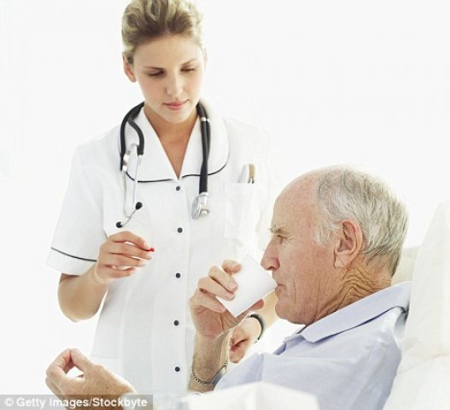
Implementation

Slide 38
Implementation
Implementing phase, provide the actual nursing activities and client responses. Implementation consists of doing and documenting the activities that are the specific nursing actions needed to carry out the interventions or nursing orders.

Slide 39
Nursing Skills during Implementation
To implement nursing care plan successfully , nurse need to have following skills
Cognitive Skills
Including problem solving and decision making
Interpersonal Skills
Include verbal and non-verbal response, communication,
Technical Skills
Includes hand on skills need to perform procedures such as administrating injection, drugs, lifting, moving

Slide 40
Evaluation

Slide 41
Evaluation
The last phase of the nursing process which include the judgment of the effectiveness of nursing care to meet client goals based on the client’s behavioral responses.
This step determine the success/effectiveness of the whole nursing process and the decision either to continue, modify or repeat the process is depend on evaluation.

Slide 42
Evaluation
While documenting evaluation phase, the nurse can draw one of the three possible conclusions:
The goal was met,
The client response is the same as the desired outcomes.
The goal was partially met,
Either a short term goal was achieved but the long term was not, or the desired outcome was only partially attained.
The goal was not met

Slide 43
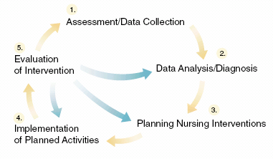
Relationship of Evaluation to Nursing Process

